Slide 1
SENG2260 Human-Computer Interaction
Week 9b: An Evaluation Framework
All images in this presentation are either licenced or labelled for reuse on Google Images.

Slide 2
aims
Introduce and explain the DECIDE framework.
Discuss the conceptual, practical, and ethical issues involved in evaluation.
Notes:
2

Slide 3
DECIDE: a framework to guide evaluation
Determine the goals.
Explore the questions.
Choose the evaluation methods.
Identify the practical issues.
Decide how to deal with the ethical issues.
Evaluate, analyze, interpret and present the data.

Slide 4
Determine the goals
What are the high-level goals of the evaluation?
Who wants it and why?
The goals influence the methods used for the study.
Goals vary and could be to:
identify the best metaphor for the design
check that user requirements are met
check for consistency
investigate how technology affects working practices
improve the usability of an existing product
Notes:
4

Slide 5
Explore the questions
Questions help to guide the evaluation.
The goal of finding out why some customers prefer to purchase paper airline tickets rather than e-tickets can be broken down into sub-questions:
What are customers’ attitudes to e-tickets?
Are they concerned about security?
Is the interface for obtaining them poor?
What questions might you ask about the design of a cell phone?
Notes:
5

Slide 6
Choose the evaluation approach & methods
The evaluation method influences how data is collected, analyzed and presented.
E.g. field studies typically:
Involve observation and interviews.
Involve users in natural settings.
Do not involve controlled tests.
Produce qualitative data.
Notes:
6

Slide 7
Identify practical issues
For example, how to:
Select users
Find evaluators
Select equipment
Stay on budget
Stay on schedule
Notes:
7

Slide 8
Decide about ethical issues
Develop an informed consent form
Participants have a right to: - Know the goals of the study; - Know what will happen to the findings; - Privacy of personal information; - Leave when they wish; - Be treated politely.
Notes:
8

Slide 9
Evaluate, interpret & present data
Methods used influence how data is evaluated, interpreted and presented.
The following need to be considered:
- Reliability: can the study be replicated?
- Validity: is it measuring what you expected?
- Biases: is the process creating biases?
- Scope: can the findings be generalized?
- Ecological validity: is the environment influencing the findings? i.e. Hawthorn effect.
Notes:
9

Slide 10
Key points
Many issues to consider before conducting an evaluation study.
These include:
goals of the study;
involvment or not of users;
the methods to use;
practical & ethical issues;
how data will be collected, analyzed & presented.
The DECIDE framework provides a useful checklist for planning an evaluation study.
Notes:
10

Slide 11
DECIDE: a framework to guide evaluation
Determine the goals.
Explore the questions.
Choose the evaluation methods.
Identify the practical issues.
Decide how to deal with the ethical issues.
Evaluate, analyze, interpret and present the data.

Slide 12
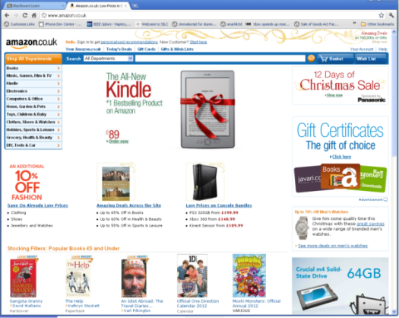


Labs this week DECIDE: A framework to guide evaluation

